Slide 1
CIS 4930/6930-002 Data Visualization
VISUALIZING TEXT
Paul Rosen
Assistant Professor
University of South Florida
slides credits Miriah Meyer (U of Utah)

Slide 2
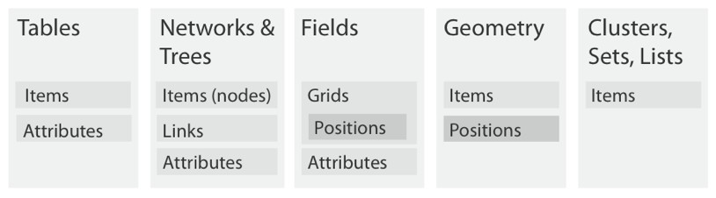
what does it mean to be an “item”?
Text
?

Slide 3
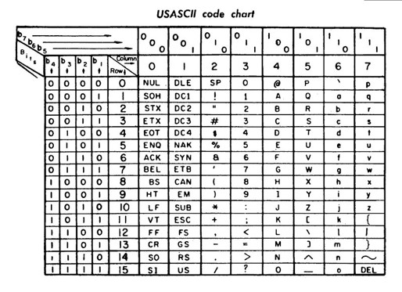
text data type
no numbers (implicitly)
characters (ASCII)
strings

Slide 4
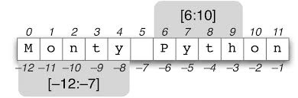
text data type
no numbers (implicitly)
characters (ASCII)
strings

Slide 5
text data semantics
words
lines
sentences
paragraphs
chapters
love
I
visualization
.
I love visualization.

Slide 6
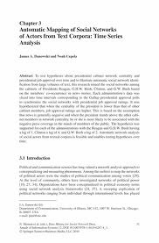
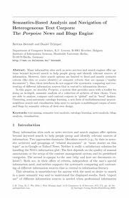
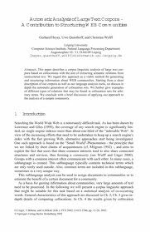
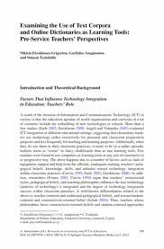
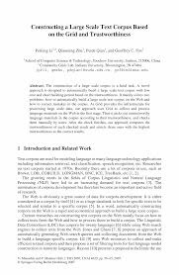
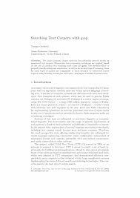
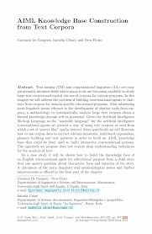
text data semantics
documents: books, papers, webpages, e-mails, twitter post
corpus: collection of documents

Slide 7
single document

Slide 8
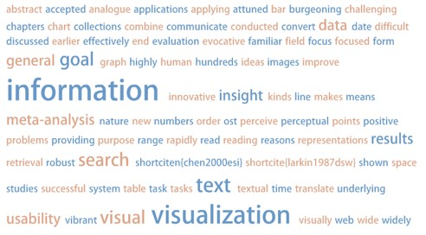
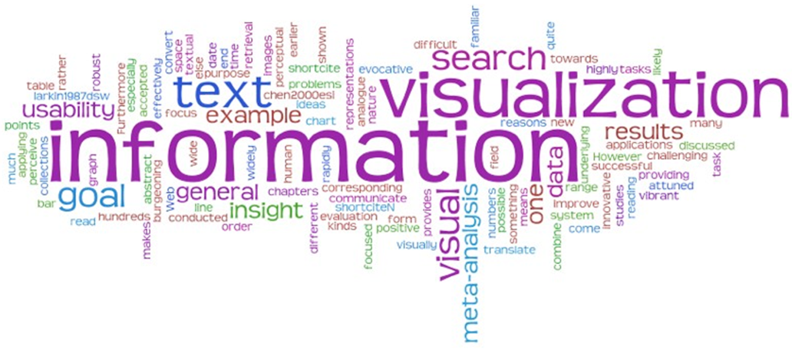
Tag Cloud / Word cloud

Slide 9
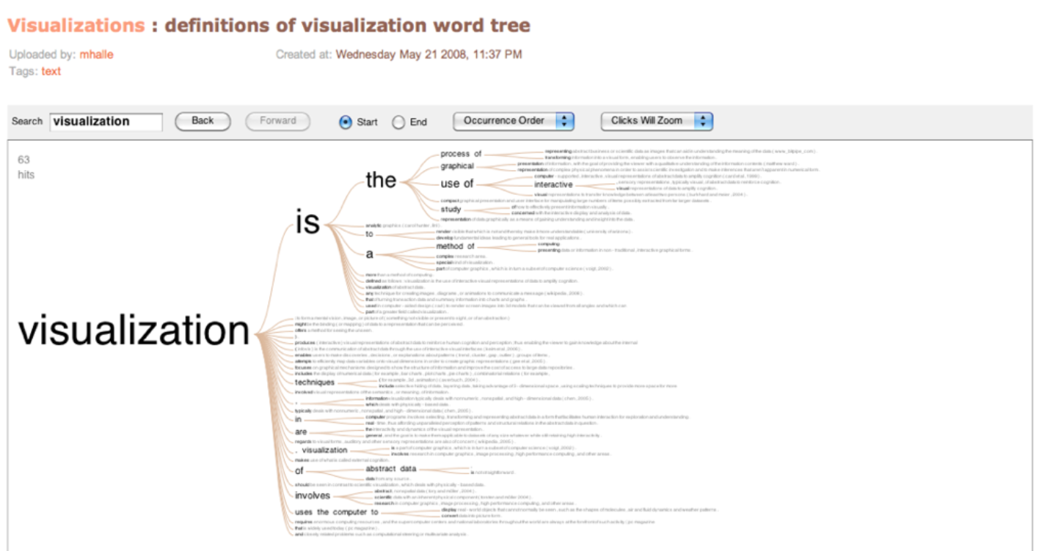

Slide 10
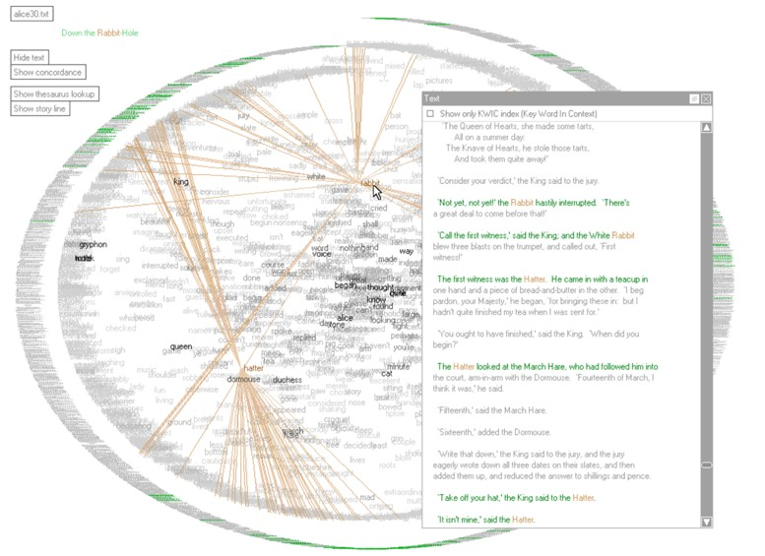
Text Arc
Wattenberg, Viegas 2008

Slide 11
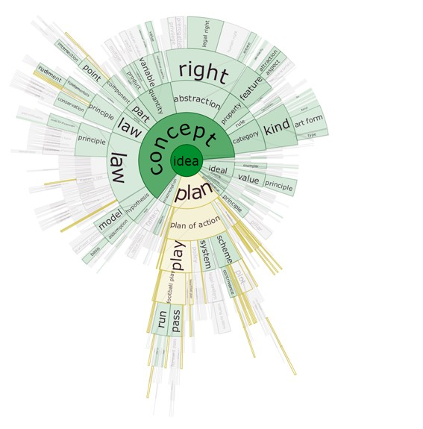
DocuBurst
Collins, Carpendale, Penn 2008

Slide 12
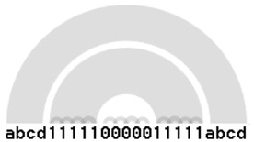
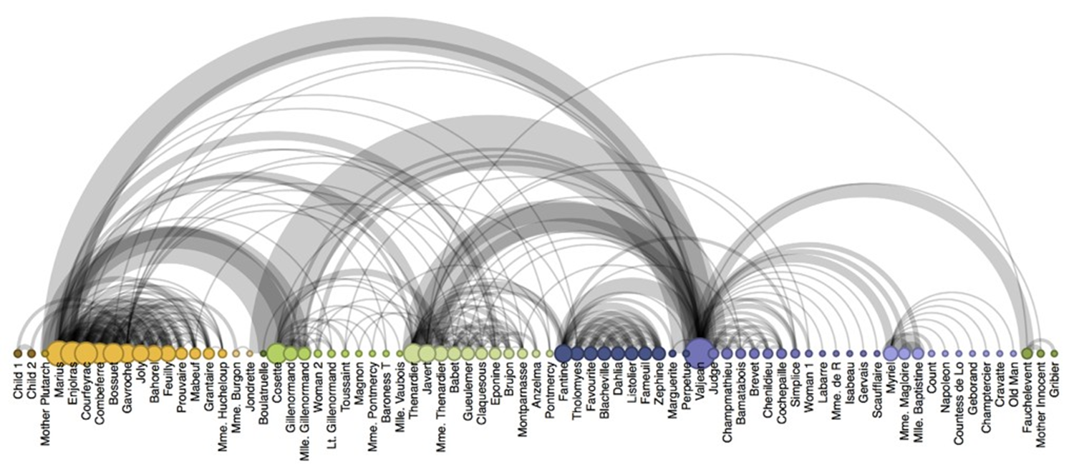
Arc Diagram

Slide 13
collection of documents

Slide 14
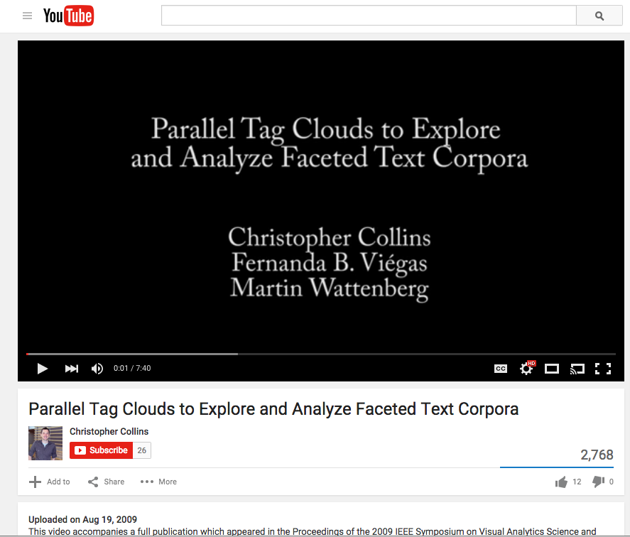

Slide 15
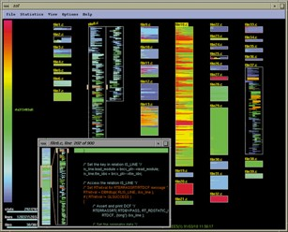
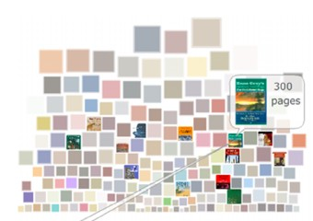
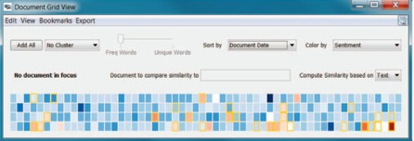
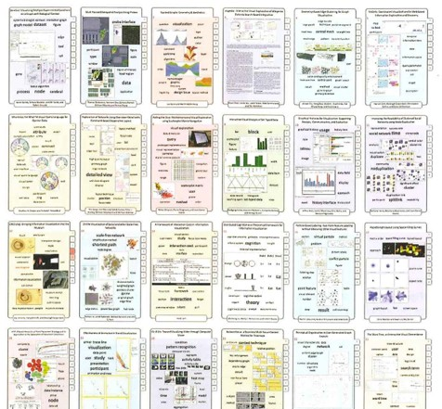
Document Cards
(small multiples)
Strobelt et al. 2009

Slide 16
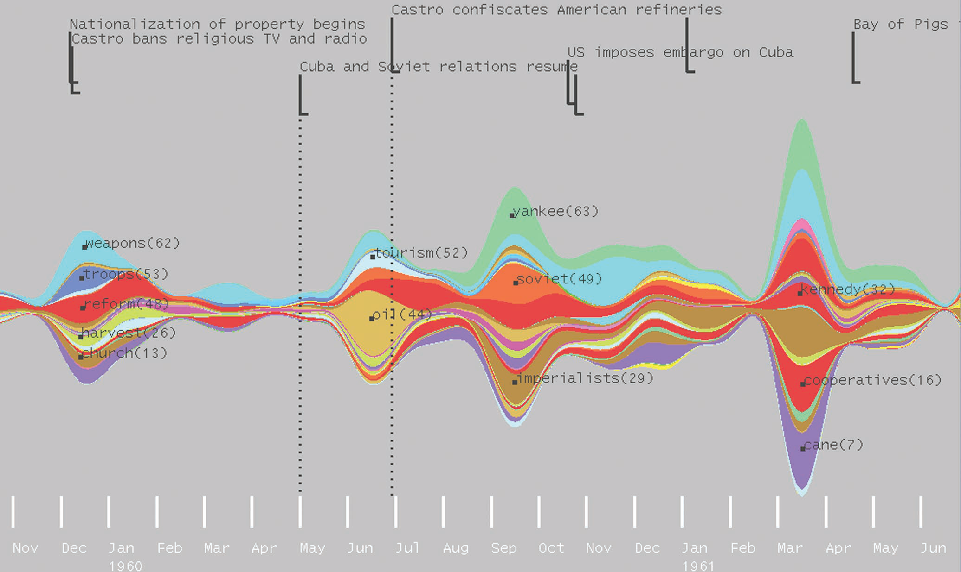
ThemeRiver – Havre, Hetzler, Whitney, Nowell 2002

Slide 17
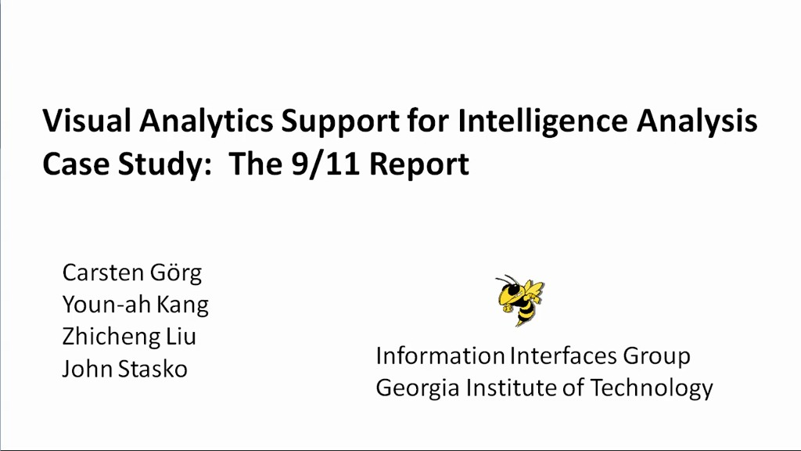
Jigsaw: Many Linked Views

